Slide 1
Python Installation
By Joe Ekstrom & Jason Densmore

Slide 2


Slide 3
Python Installation for VSCode

Slide 4
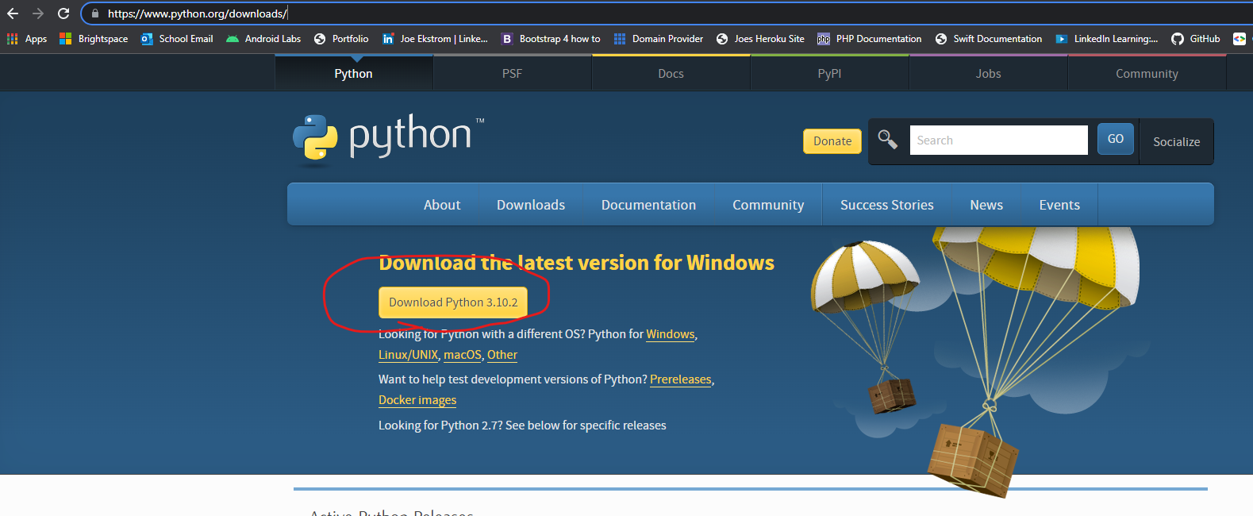
Python Installation - Step 1
Go to https://www.python.org/downloads/ and download the latest version of python

Slide 5
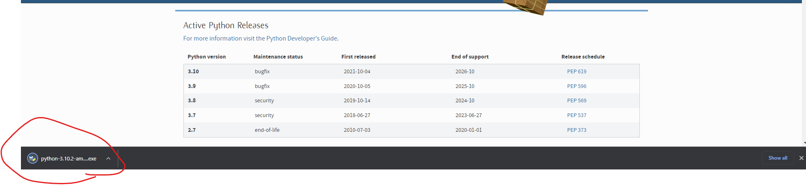
Python Installation - Step 2
Once downloaded, launch the installer

Slide 6
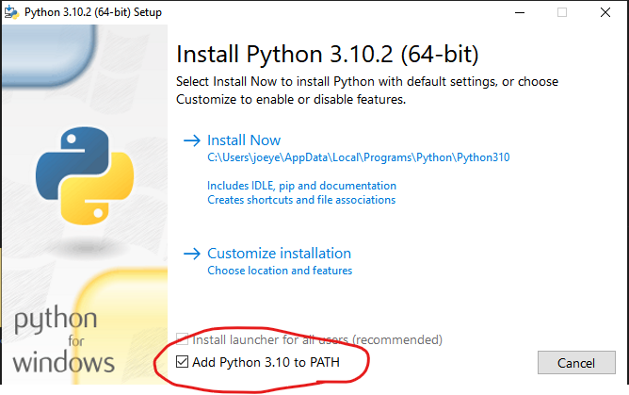
Python Installation - Step 3
IMPORTANT! Once the installer launches, make sure you check the “Add Python (version) ” to PATH.
Rather than pressing Install Now. Were going to Press “Customize installation”

Slide 7
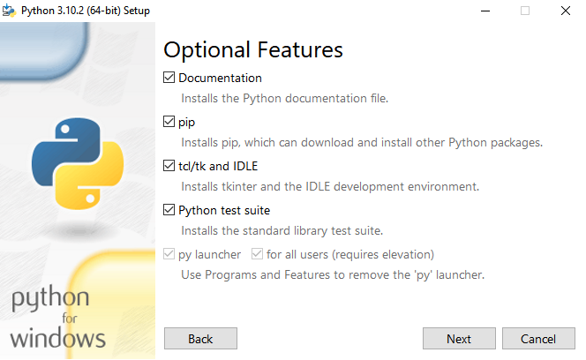
Python Installation - Step 4
Inside Optional Features, leave the defaults, and click Next.

Slide 8
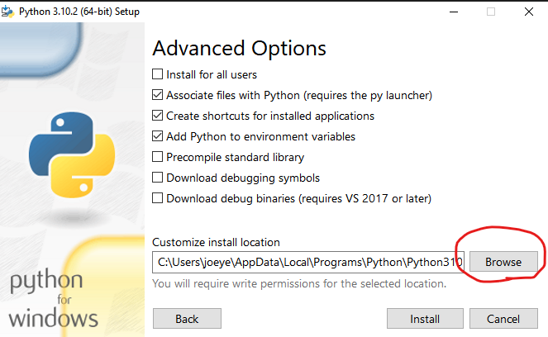
Python Installation - Step 5
Inside Advanced Options, leave the defaults, Click browse and place the installation in a spot you can easily navigate to. After which you will press “Install”

Slide 9
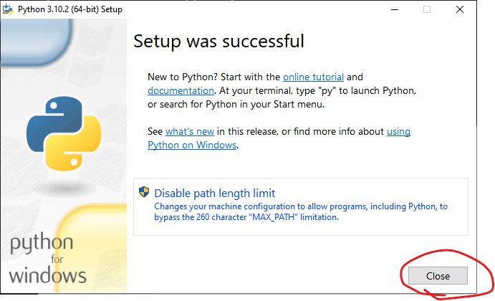
Python Installation - Step 6
Press close.

Slide 10
Python Installation - Step 6
The Next thing we're going to to is set up an environment variable for python using the location of the python installation we just setup.

Slide 11
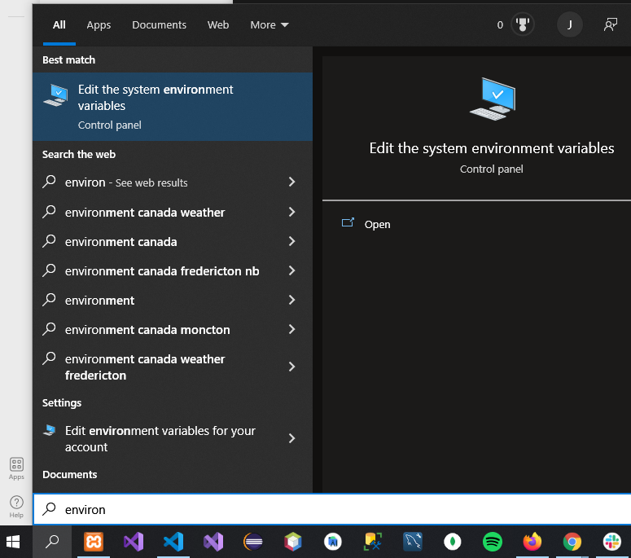
Python Installation - Step 7
In the windows search bar, enter “Environment”, then press the “Edit the system environment variables.

Slide 12
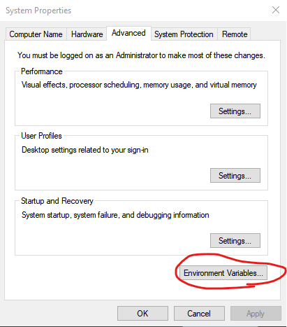
Python Installation - Step 8
Once inside the context menu, click “Environment Variables”

Slide 13
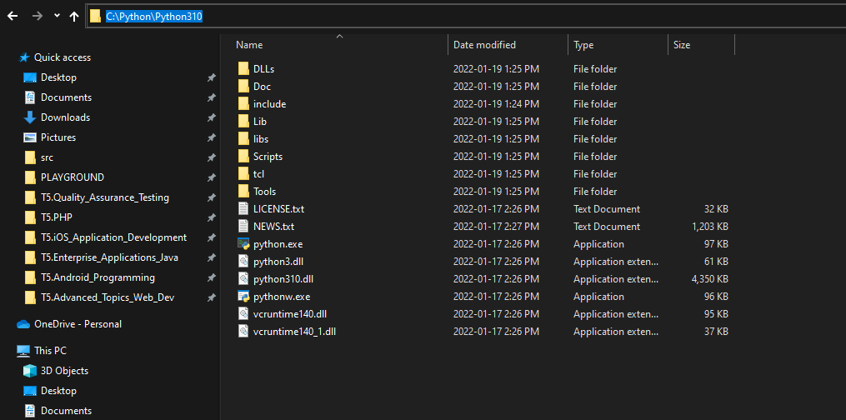
Python Installation - Step 9
Once inside the context menu, click “Environment Variables”.
Then open file explorer and navigate to where you placed your python folder, after which you will copy the path to that folder.

Slide 14
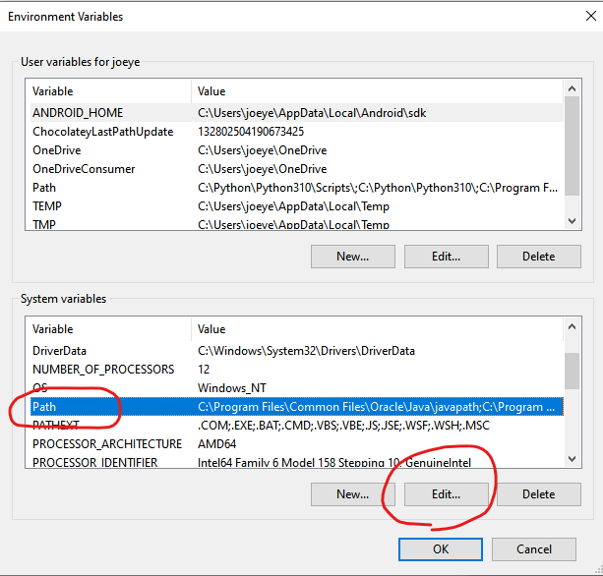
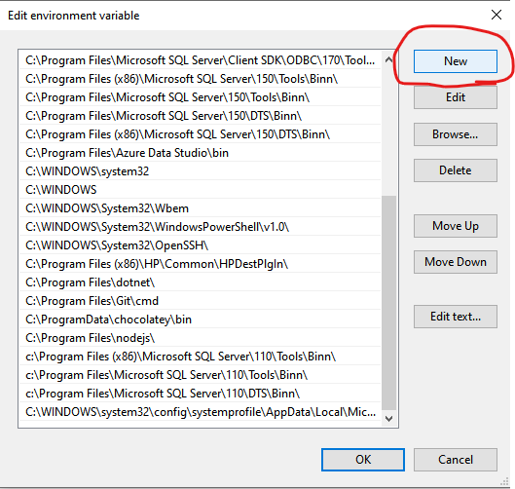
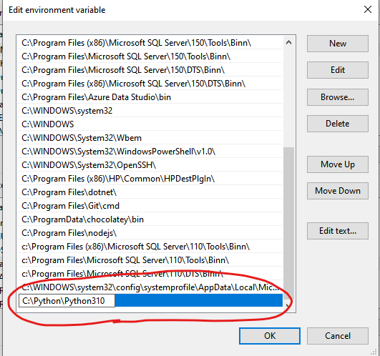
Python Installation - Step 10
Open the Environment variables and under “System Variables”, press the “Path” variable -> Edit -> New. then paste the path to your python folder we got in the previous step, then press “OK” -> “OK” -> “OK”.
This will allow us to use python commands inside the command prompt.

Slide 15
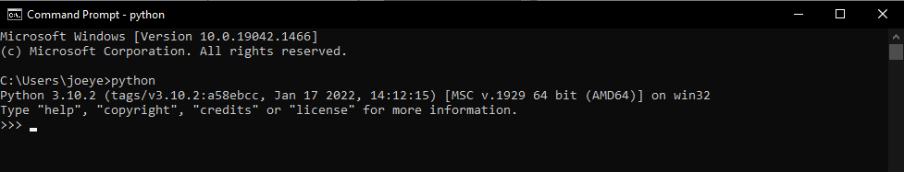
Python Installation - Step 11
To test if the installation was successful, open the command prompt, and type “python”.
You should see the below output:

Slide 16
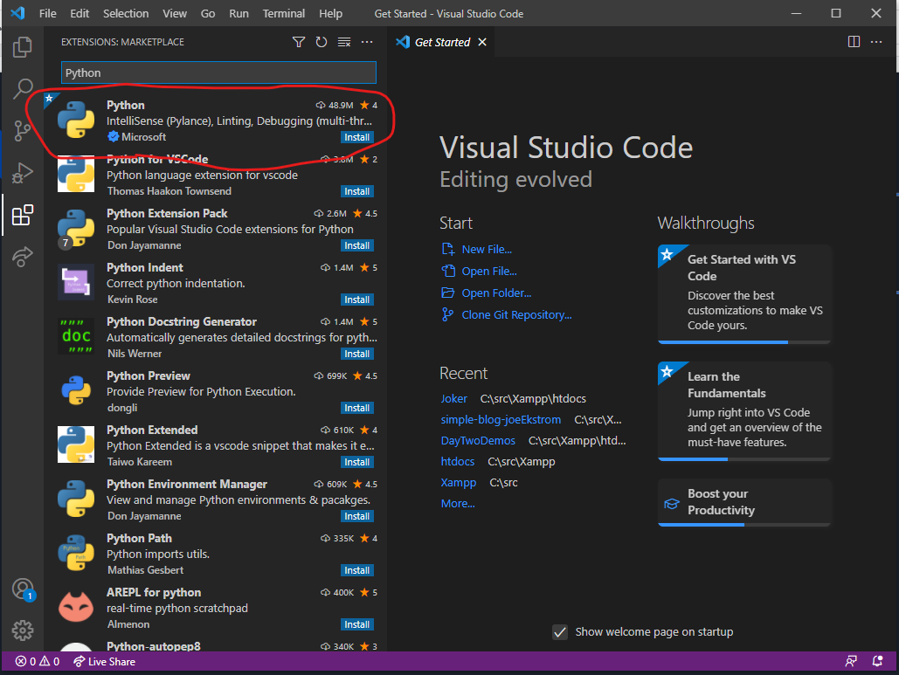
Python Installation - Step 12
Open a new Instance of Visual Studio Code
Click on Extensions -> Type “Python” in the search
Install the one created by Microsoft.

Slide 17
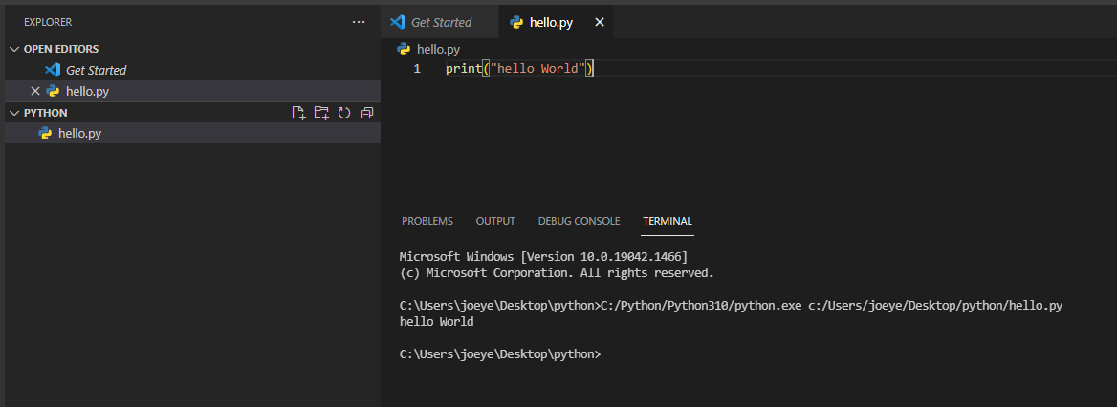
Python Installation - Complete!
You’ve Successfully installed python!

